Slide 2
WS1TT Single Head Twin Highlights
Service flow 28 gpm, backwash flow of 15 gpm with meter and bypass installed
Solid state microprocessor with easy access front panel settings
Front panel display for time of day, days until next regeneration, volume remaining,
current flow rate, total volume used (Totalizer), and Tank in Service Indication
Four methods to initiate regeneration; meter immediate, meter delayed, time clock
delayed, or pressure differential delayed or immediate
Fully adjustable 6-cycle control delivers controlled backwash, downflow brining/ slow
rinse, second backwash, fast rinse, refill and downflow service
Days override feature 1 – 28 days available
Backwash and brining ability to 21” diameter tanks
Downflow/ Upflow regeneration
Soft/ treated water regeneration
Pre or Post Treated water regeneration
Stores system configuration and operation data in non volatile memory
Coin cell lithium battery back-up with 8 hour power carry over
12-volt UL Output AC Adapter efficiency marking V (Energy Star 2.0)
Patented one piece expanding seal spacer stack assembly U.S. Patent 6,402,944
Patented linearly reciprocating piston operation U.S. Patent 6,444,127
1 Relay driver
Reliable and proven DC drives

Slide 3
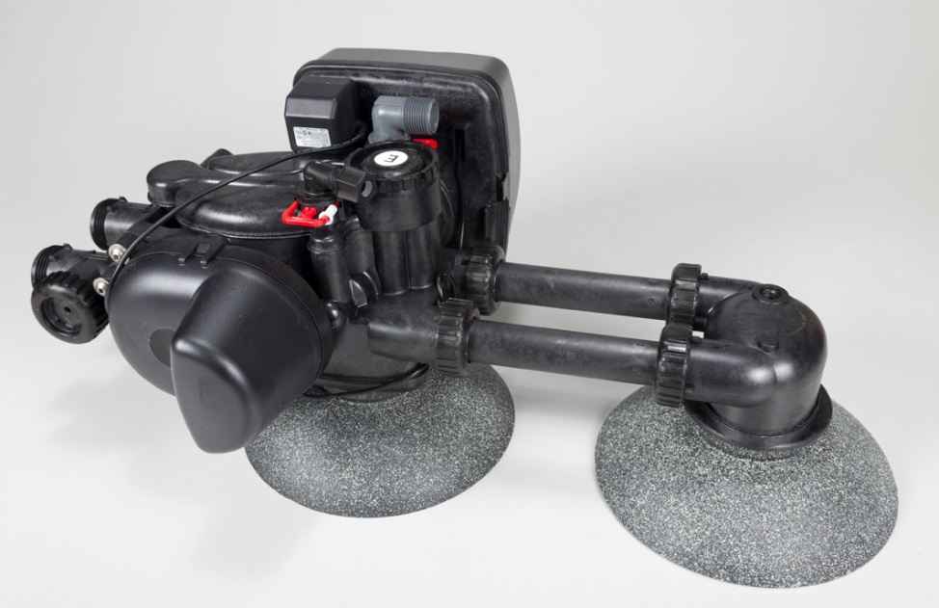
WS1TT Single Head Twin Specs
Service 28 gpm @ 15 psi drop with meter and bypass installed
Backwash 15 gpm @ 25 psi drop with meter and bypass installed
1.05” distributor tube cut-off height is + ½” top of tank
Materials suitable for most regenerants.
Easy locking drain/ brine clip for easy removal
Standard ¾” Male NPT 90° drain elbow that swivels 180° for easy orientation
3/8” compression brine elbow that swivels 270° for easy orientation
Built in internal flow meter off the side of the outlet port for easy maintenance
Operating pressure of 20 psi – 125 psi
Operating temperature of 40° - 110°F

Slide 4
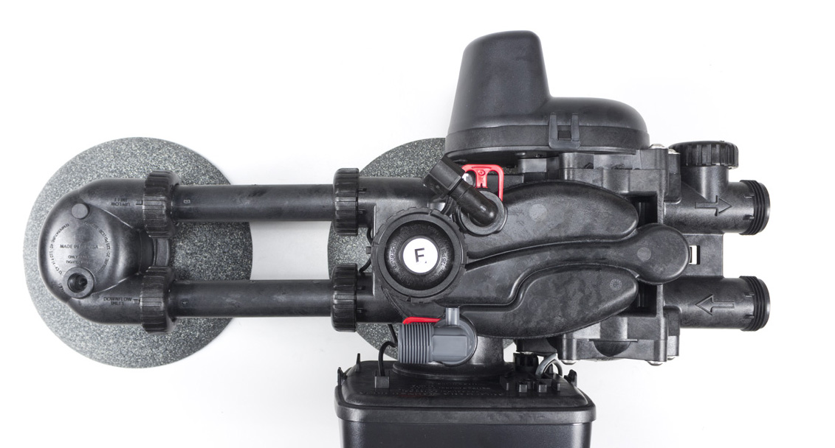
WS1TT Single Head Twin Top View
Factory Cross-over Tubes for 10” Diameter Tanks and Smaller
Meter Port
Brine Connection
Outlet
Inlet
Drain Connection
Factory Cross-over Tubes will work with Tank Jackets

Slide 6
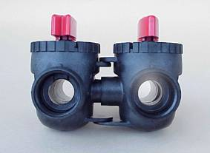
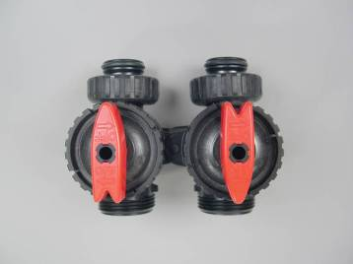
Bypass
Directional shut-off arrows for flow: Normal, Bypass, Diagnostic mode, Shut-off mode.
Radial seals allow side-to-side and up/down minor plumbing misalignments, connections need only hand tightening.
One internally lubricated O-ring on rotor creates less friction.
INLET
OUTLET

Slide 7
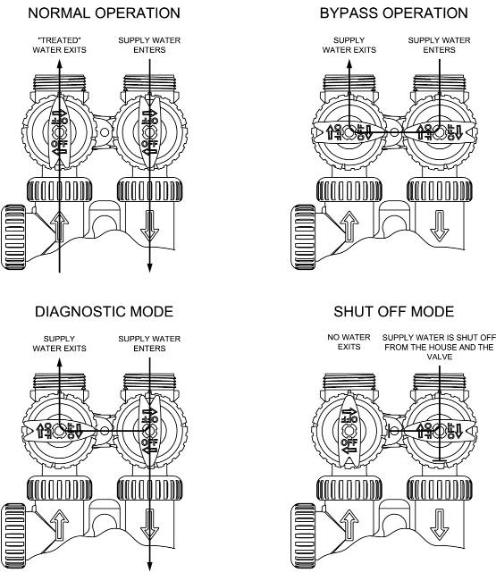
Bypass Valve Operation

Slide 8
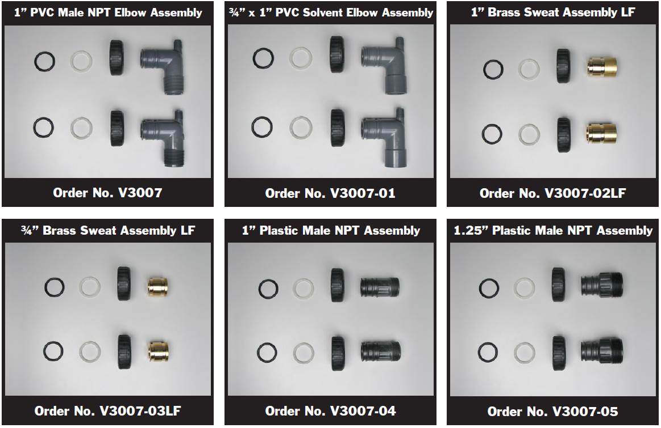
Fitting Packages

Slide 9
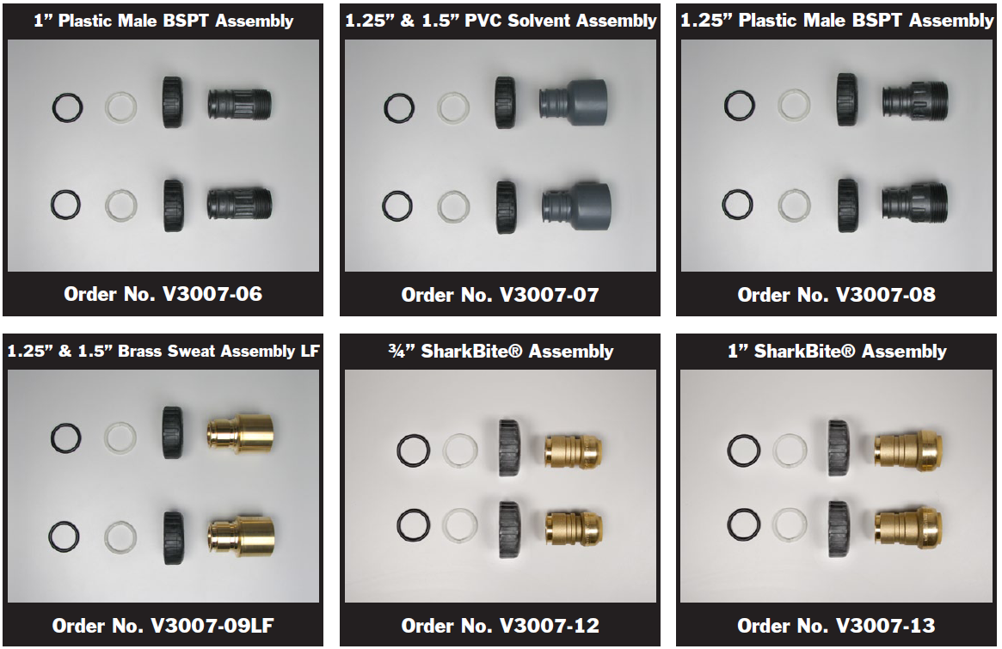
Fitting Packages

Slide 10
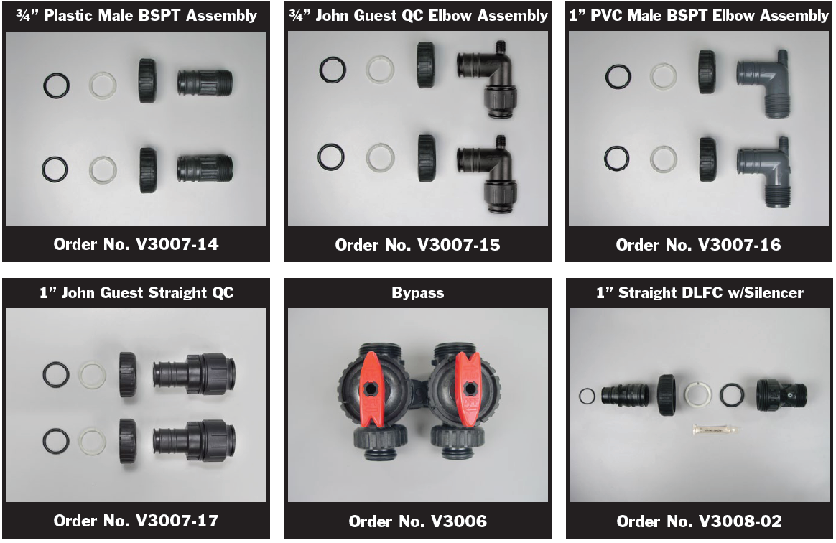
Fitting Packages & Accessories

Slide 11
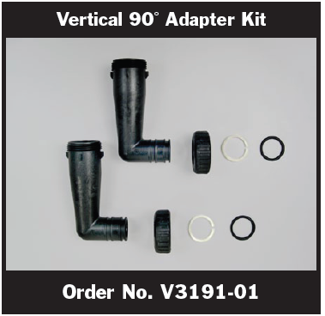
Fitting Packages & Accessories

Slide 12
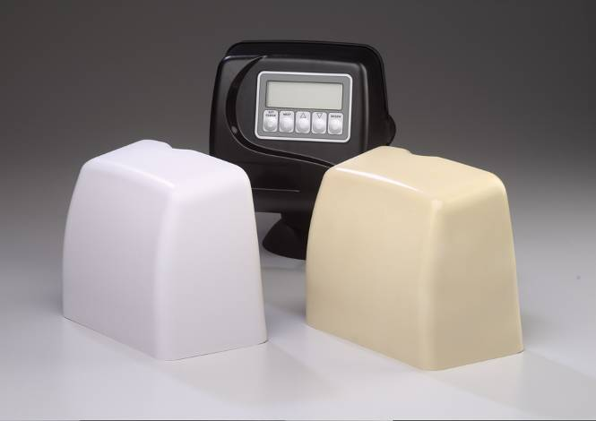
Weather Covers
V3175WC-W (White)
V3175WC-A (Almond)

Slide 13
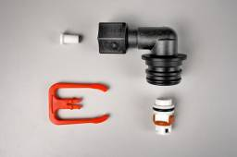
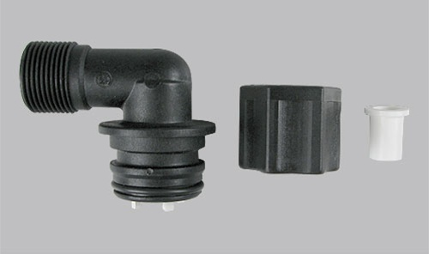
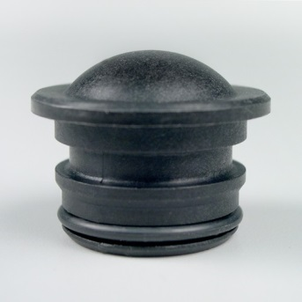
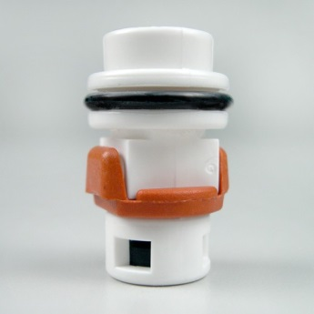
Regenerant refill Options
Locking clip for easy removal
BLFC 0.5 gpm refill only
V3498
V3195-01
Optional Brine elbow available for 1/2” OD tubing with 0.5 gpm BLFC
Refill port plug is used on Backwash only valves
(Orange flapper valves close in refill and open for higher draw rates to allow greater flow through during draw)

Slide 14
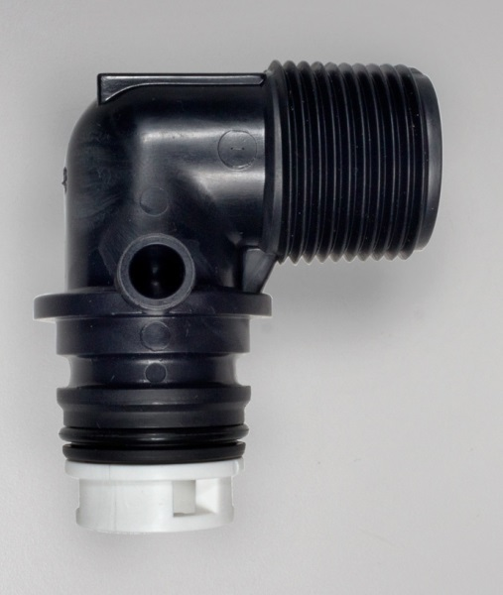
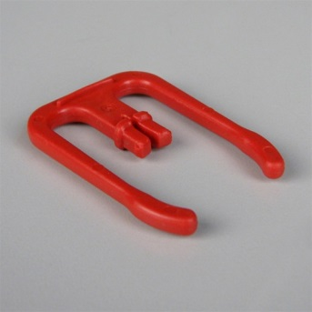
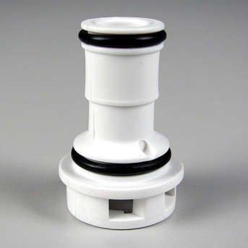
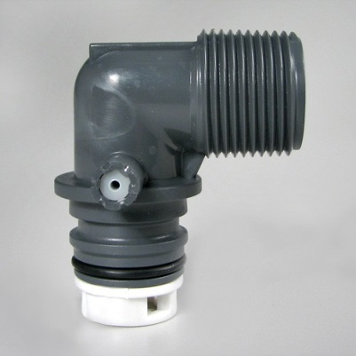
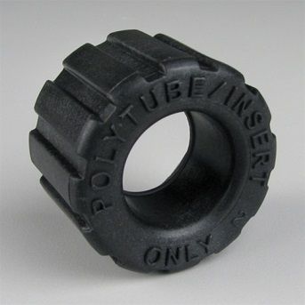
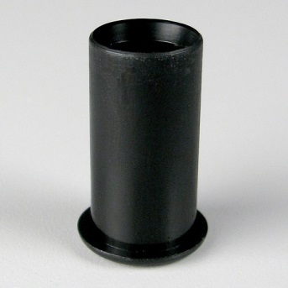
Drain Fitting
Easy locking clip removal. Orient in any direction
3/4” NPT thread standard or 5/8” OD polytube (requires optional separate tube insert & nut)
Brine and drain fittings cannot be interchanged (Prevents misapplication)
Available DLFC’s from 0.7 up to 10.0 gpm
V3962
Optional Nut & Insert
Sold separately
V4057

Slide 15
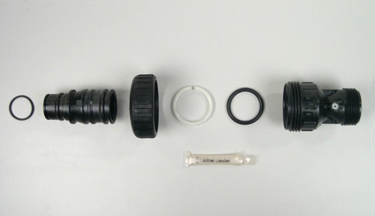
1” Male NPT Straight with Silencer V3008-02
For Flows up to 25 GPM
Separate DLFC buttons from 9.0 GPM – 25.0 GPM are available

Slide 16
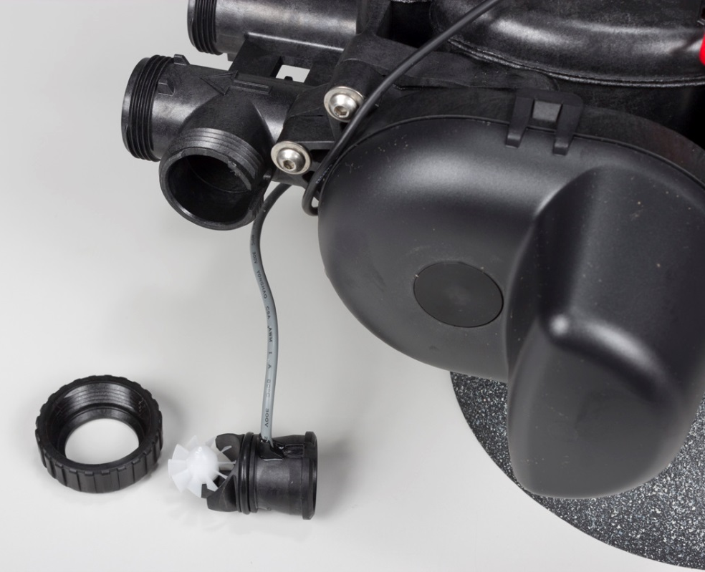
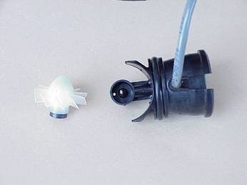
Meter
Measures from 0.25 to 28 gpm + 5% accuracy.
Hall effect chip picks up magnetic pulse and an icon will flash in the display just underneath the flow rate label when water is flowing
Easy to replace turbine
Shielded magnet
Hall effect
Magnet

Slide 17
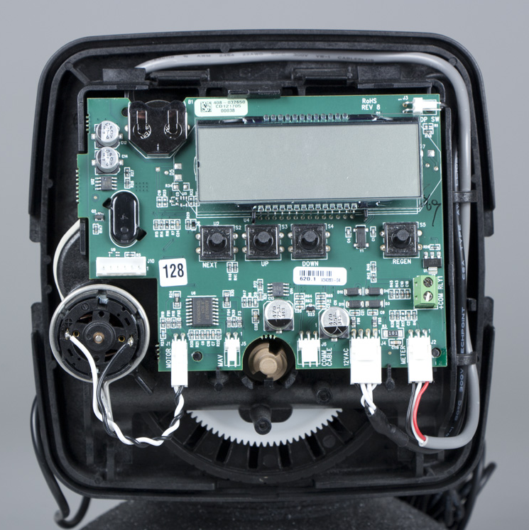
Easy access
Differential Pressure Switch Connection
Coin Cell Lithium Battery
(3 volt type 2032)
Software Revision
Terminal Block for Relay 1 driver
Motor
Meter
MAV/ NHWBP Drive Connection
Interconnect Cable for MAV
12VAC Power

Slide 18
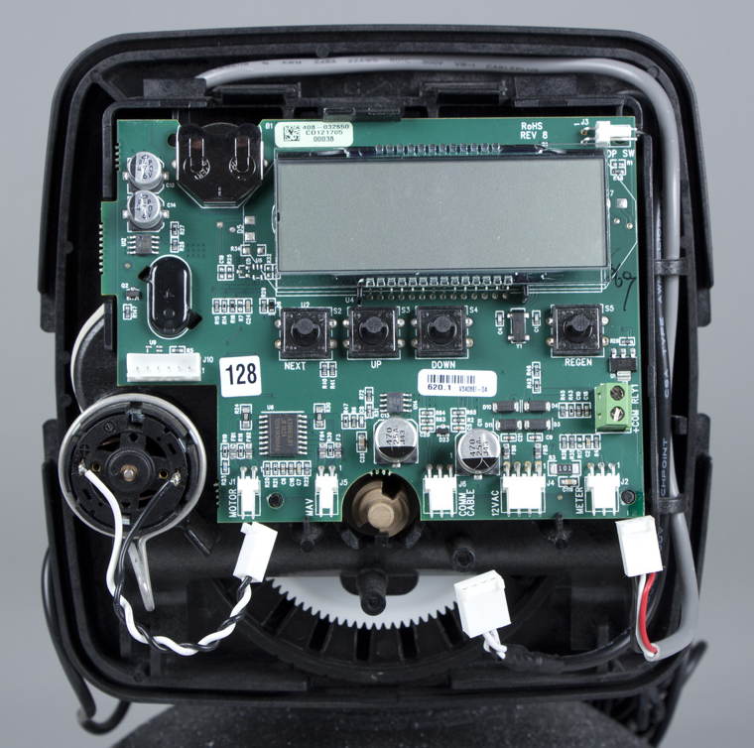
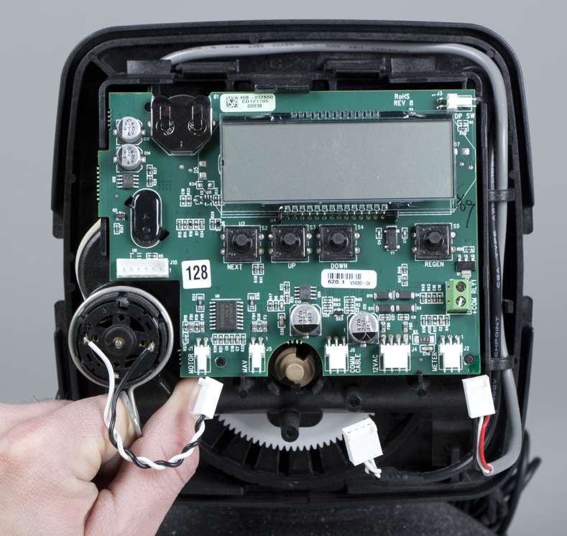
Drive Motor Removal
12 VAC power
Disconnect wires from PC Board, power 1st
Always connect power last when re-connecting wires
Press motor locking spring to the right
With other hand grab motor wires close to motor & rotate motor left to right while pulling out on motor to remove

Slide 19
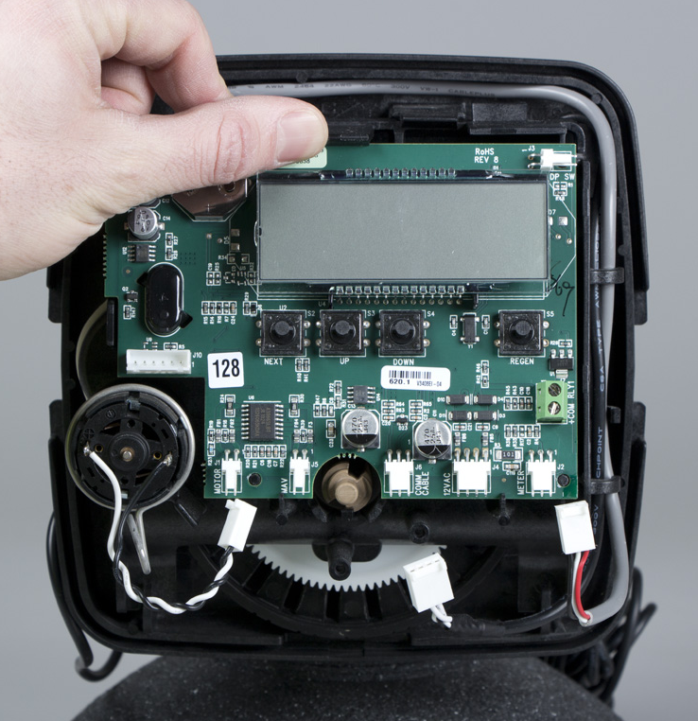
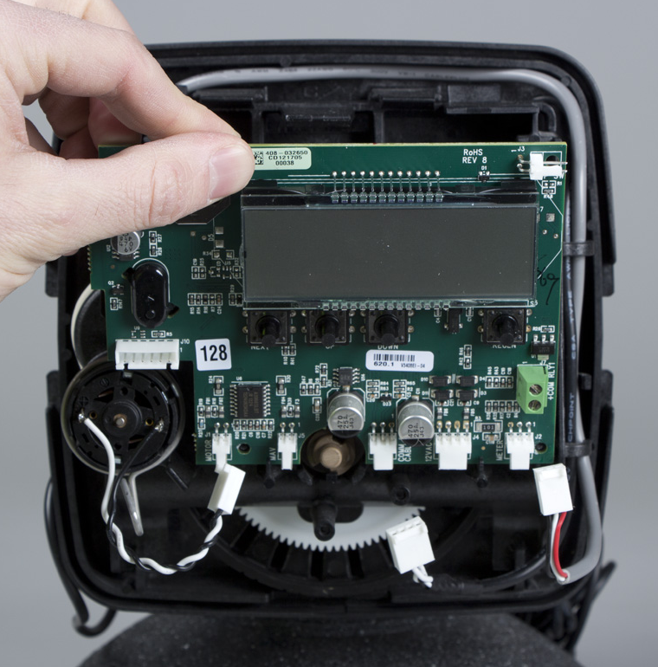
Removing the PC Board
Press up on locking tab
Pull top of PC Board forward.

Slide 20
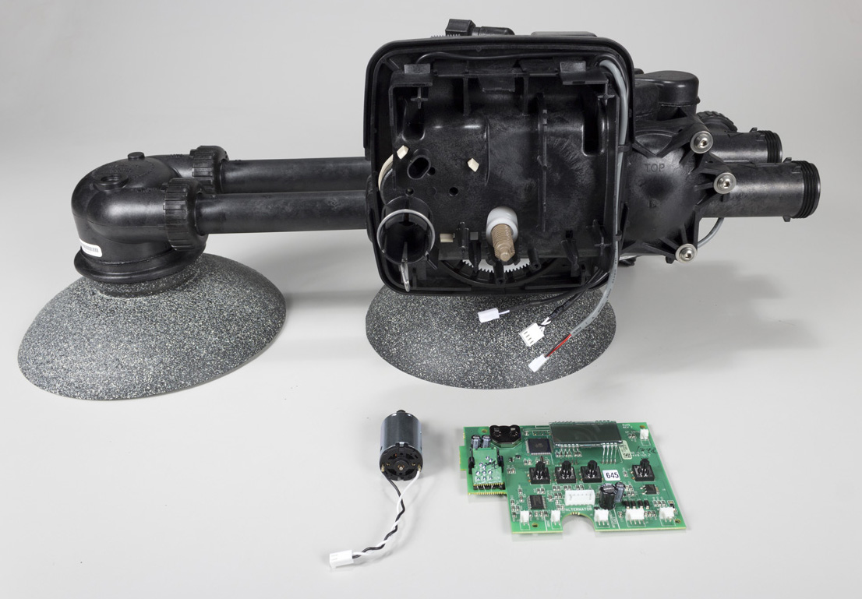
Removing Drive Bracket
Finger Tab
Finger Tab
Lift up on the two tabs as indicated
Pull top of drive bracket forward, using finger tabs.

Slide 21
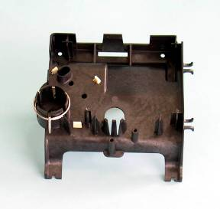
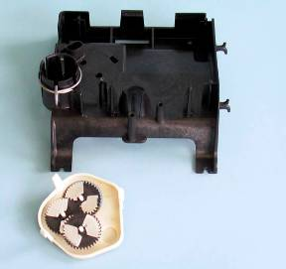
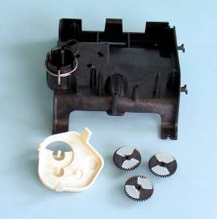
Removing the Gear Box
Remove gear box by pushing in on the beige locking tabs
Gears can be removed by pulling them off of their posts
All three gears are identical

Slide 22
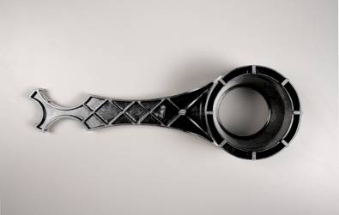
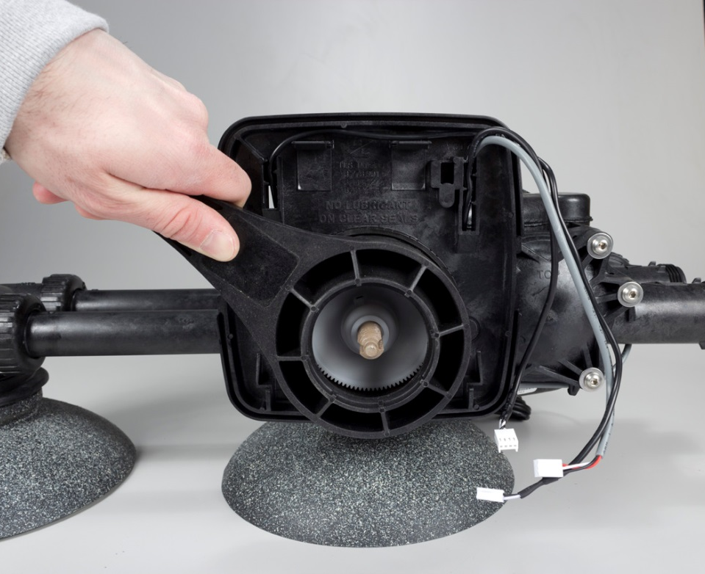
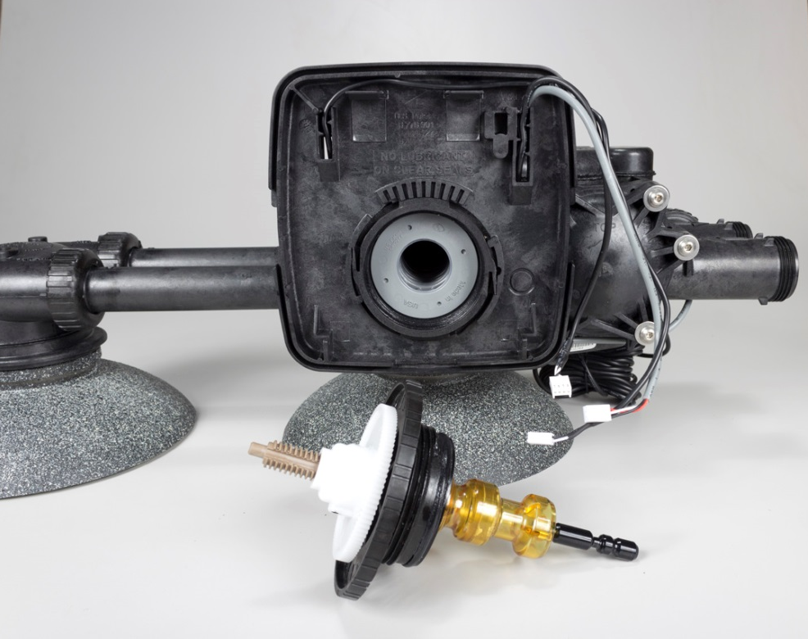
Removing Drive Cap
WS1 Service Wrench
Unscrew drive cap assembly with wrench

Slide 23
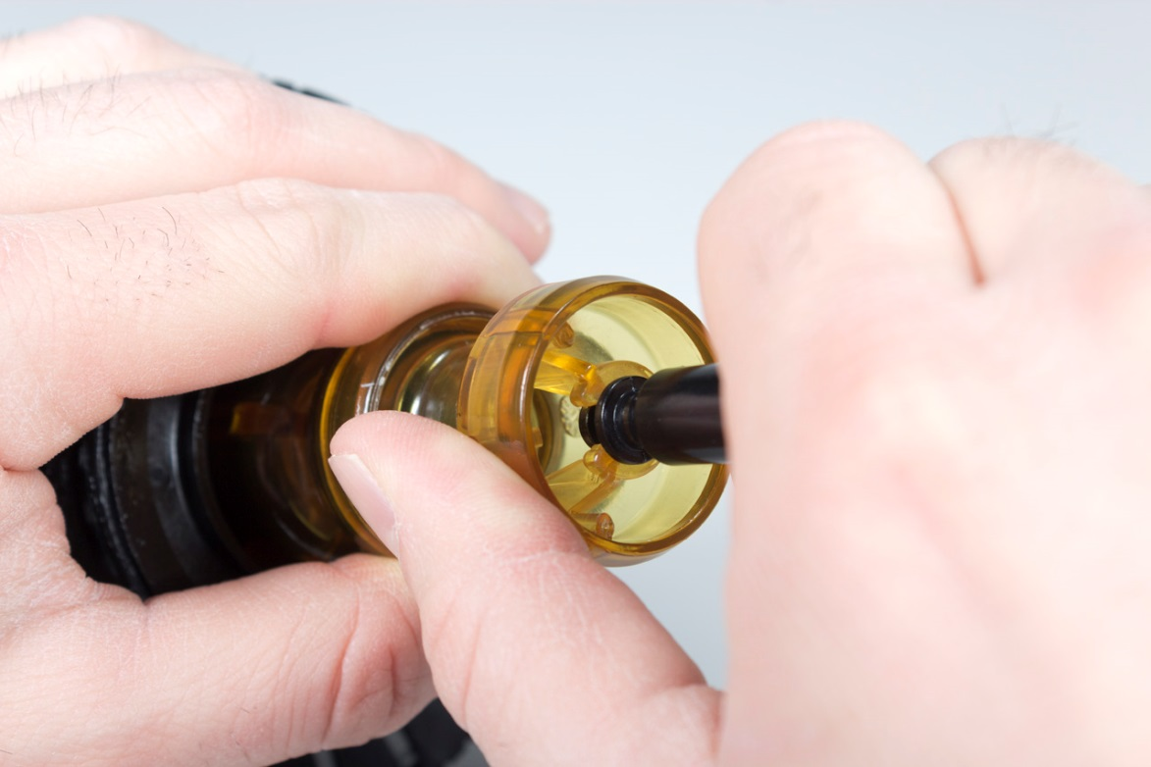
Brine Piston Removal
Apply slight side pressure
Brine Piston is easily removed with a horseshoe style snap lock connection
Brine Piston is not used with backwash only filters

Slide 24
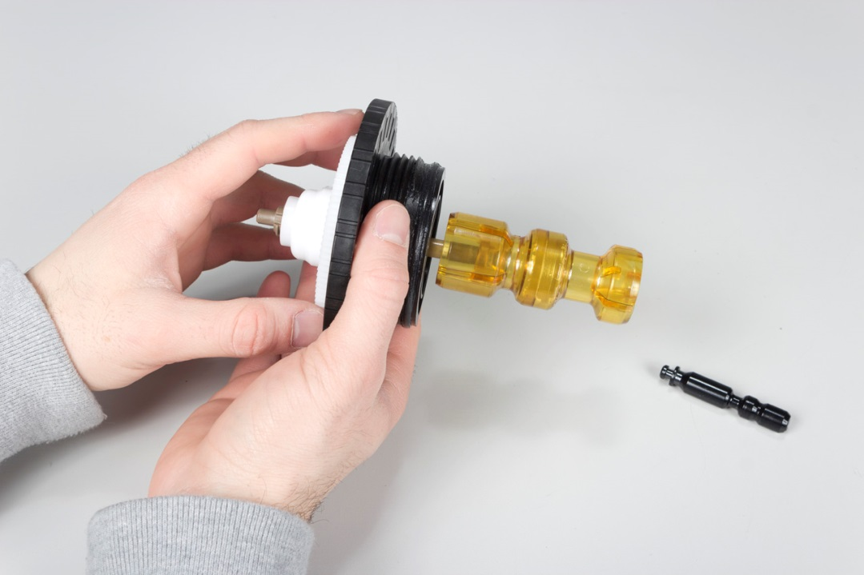
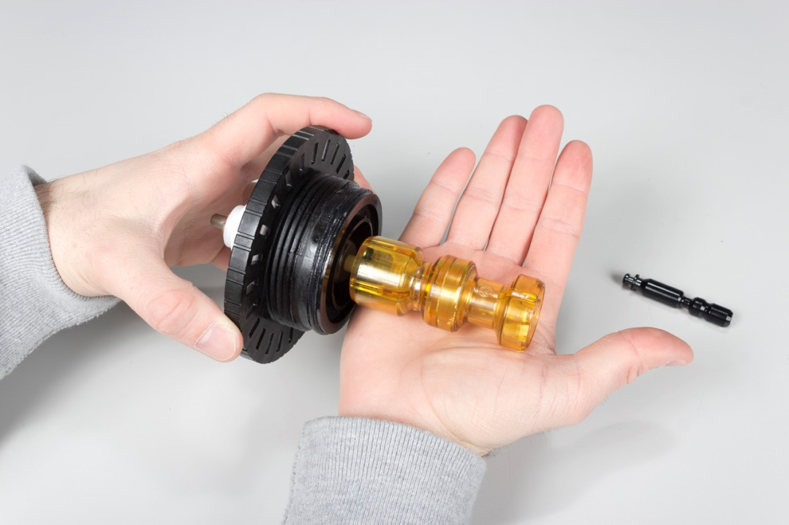
Main Piston Removal
Hold drive cap and spin white main drive gear to extend main piston away from drive cap
Hold drive cap over the palm of your hand and press down while rolling the piston forward across the palm of your hand
This will have the main piston easily snap off in your palm

Slide 25
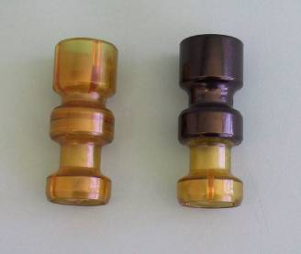
Downflow & Upflow Pistons
Downflow
Upflow
Separate pistons are used for downflow or upflow applications
Downflow piston is a solid amber color
Upflow piston is a black and amber color
** EE Twin Valve is not able to perform Upflow Brining at this time

Slide 26
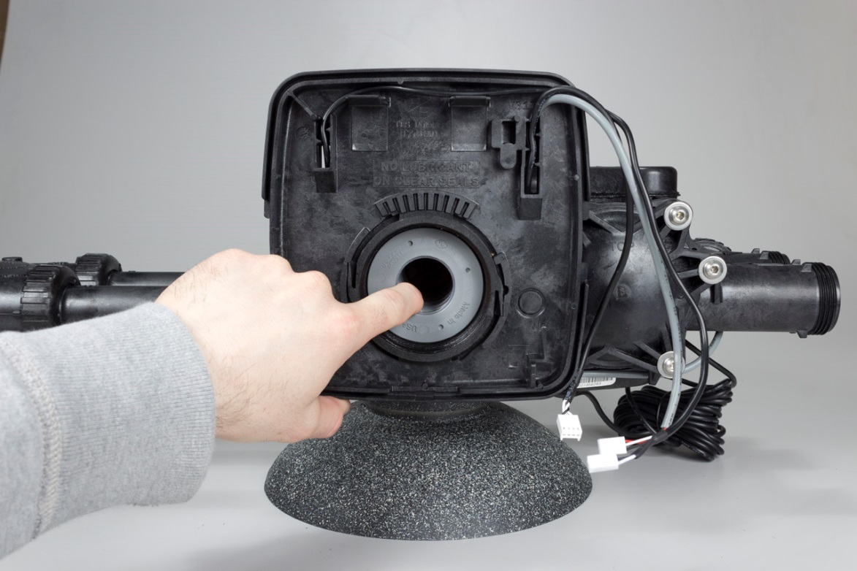
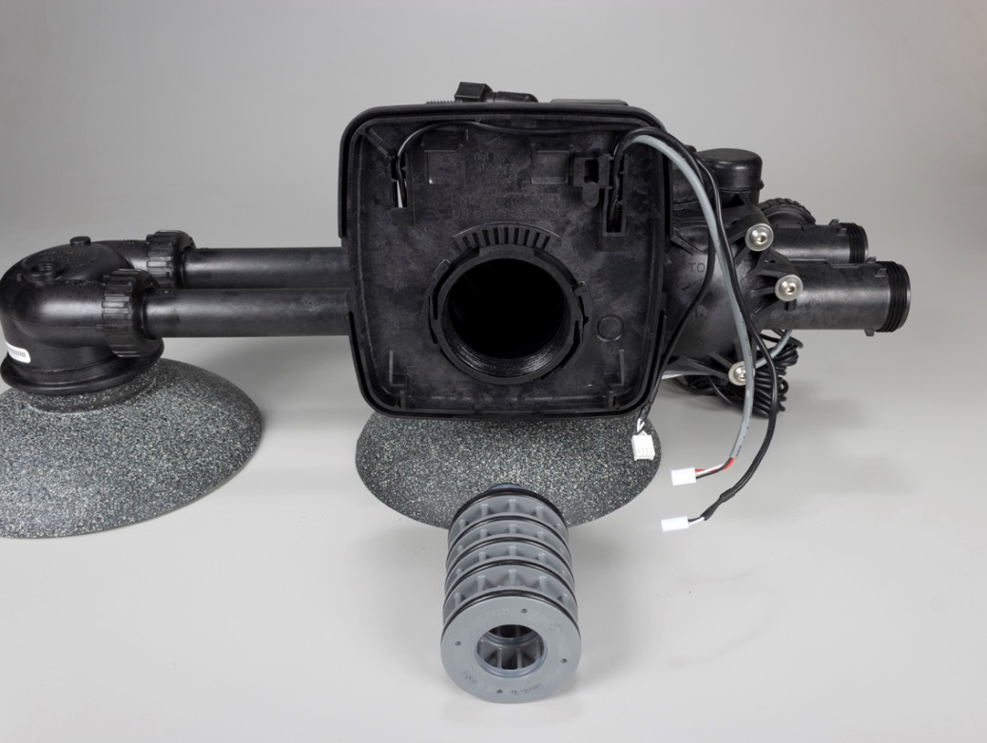
Seal Spacer Stack Assembly Removal
Spacer stack assembly is removed by simply pulling stack out

Slide 27
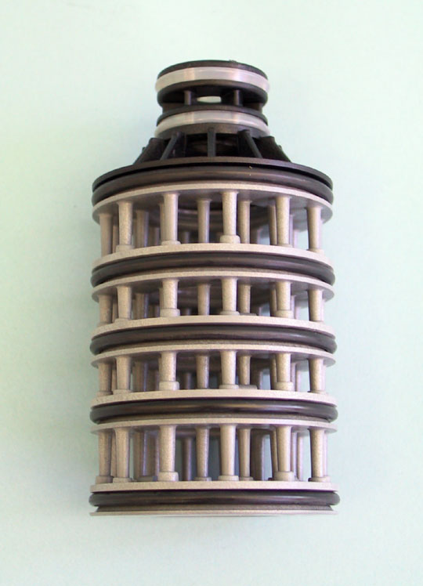
Spacer Stack Assembly
Regenerant Valve Draw/ Refill
Regenerant Valve Distributor Tube Port
Regenerant Valve Feed Water
Regenerant Valve Top of Tank Port
Regenerant Valve Drain
One-piece replaceable assembly
Assembly is designed to compress and seal when tightening drive cap back into control valve

Slide 28
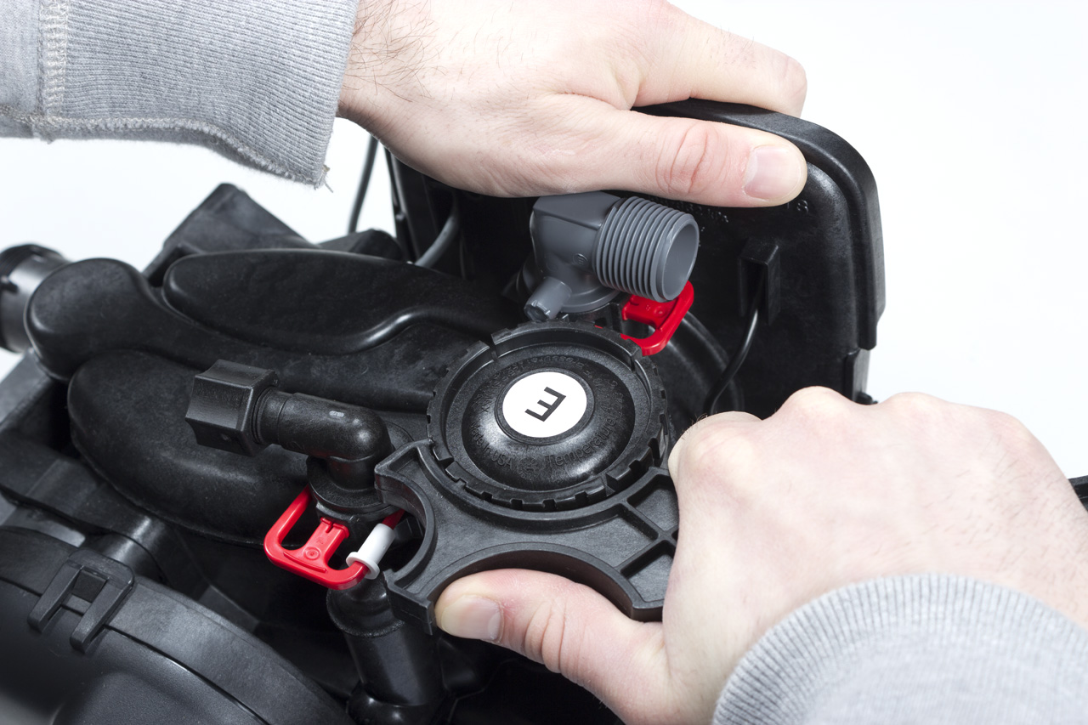
Injector Cap Removal

Slide 29
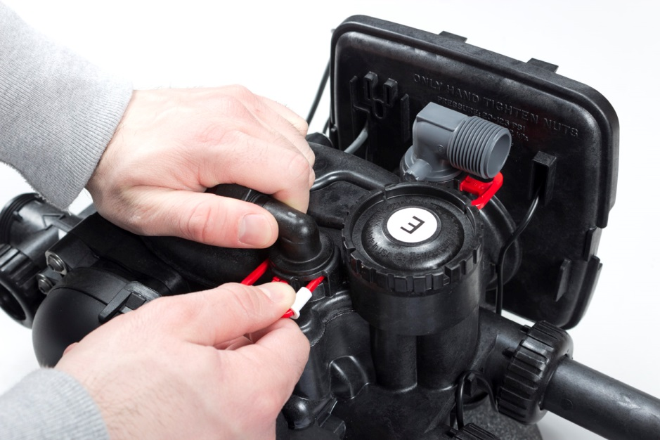
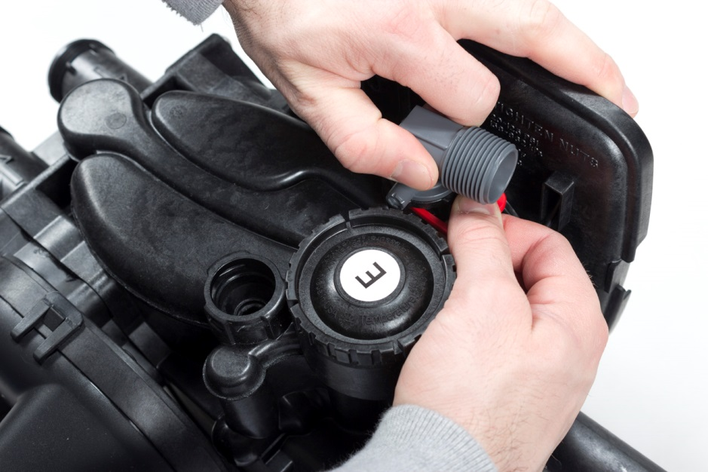
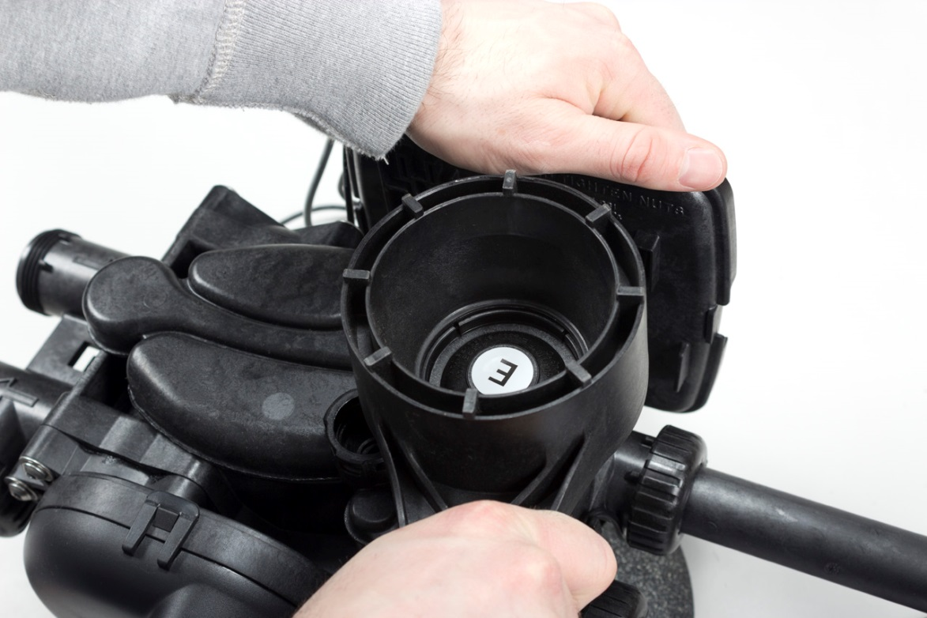
Injector Cap Removal

Slide 30
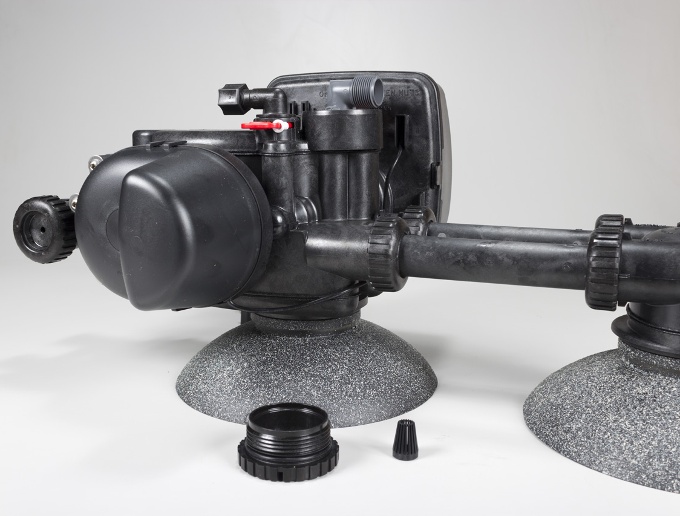
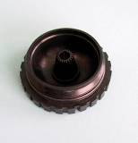
Injector Cap & Screen
Injector screen pulls out of cap for easy cleaning.

Slide 31
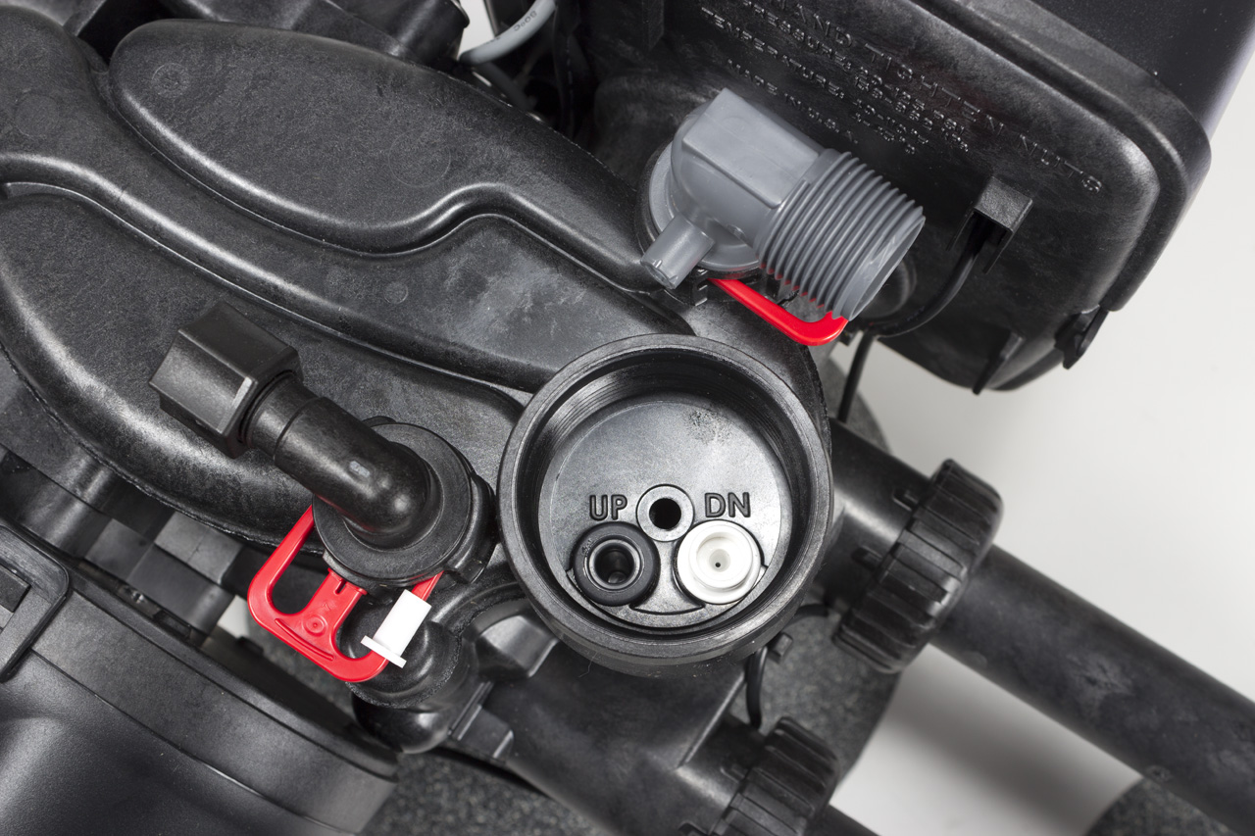
Injector Position
Injector is placed in brine flow direction hole: DN - downflow brining; UP - upflow brining
A plug is used in the other port
Picture displays a control for downflow brining
Note: A downflow control valve CAN be converted into an upflow control valve or an upflow into a downflow

Slide 32
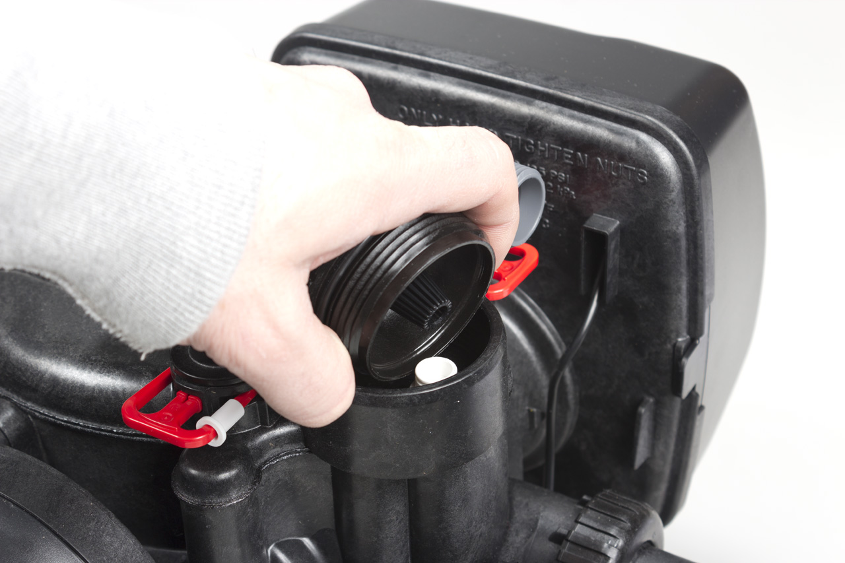
Injector Removal
To remove injector use injector cap and scoop the top rim of injector with the bottom of the injector cap

Slide 33
Injector Plug
When shipped from the factory as a backwash only filter, the brine piston and injector will not be included. (Plugs are used to block injector passages.)
If field converting from a softener to a backwash only filter, only a refill port plug is necessary.
Note: If the brine piston is left in the control when converting to a backwash only filter, the injector must also be left in the control valve.

Slide 34
Injector Sizes
Typical Tank Diameter
Downflow WS1 & WS1.25 | Upflow WS1 Only
6” | 8”
7” | 9”
8” | 10”
9” | 12”
10” | 13”
12” | 14”
13” | 16”
14” | 18”
16” | 21”
18”
21”
Injector Order Number | Injector Color
V3010 – 1A | Black
V3010 – 1B | Brown
V3010 – 1C | Violet
V3010 – 1D | Red
V3010 – 1E | White
V3010 – 1F | Blue
V3010 – 1G | Yellow
V3010 – 1H | Green
V3010 – 1I | Orange
V3010 – 1J | Light Blue
V3010 – 1K | Light Green
Injector sizes based on typical tank diameter are designed for standard cation exchange water softeners only

Slide 35
Backplate Removal in Order to Service Front Transfer Cap
Hold slight pressure downward

Slide 36
Front Transfer Cap Removal
Use a 5/32 allen wrench (T-Handle preferred)
Remove bolts

Slide 37
Front Transfer Cap Removal
After bolts are removed firmly grab transfer cap and twist and pull away from the valve body

Slide 38
Front Transfer Disc
Raw/ Untreated water inlet flow path to Tank A for service

Slide 39
Remove Front Transfer Disc
Simply pull out disc away from valve body

Slide 40
Transfer Disc
Front Side
Seal Surface Side
Seal surface side has a friction reducing coating

Slide 41
Remove Front Transfer Disc Seals
Carefully pick out seal from port cavity

Slide 42
Front Transfer Disc Seals
All seals have a lip, it is important that this lip faces out when installing seals into cavity ports
Transfer seals are the same in the front and back transfer side of the valve
Same material as spacer stack seals

Slide 43
Front Transfer Ports
A
B
With transfer cap off, think of reading from left to right, therefore the lower port on the left is for Tank A and the lower port on the right is for Tank B
The upper port is the regenerant top of tank port that ties the regenerant to A or B during regeneration

Slide 44
Back Transfer Drive Cover Removal
Carefully lift out on cover locking tabs to remove drive cover

Slide 45
Transfer Drive Motor Removal
Squeeze spring clip in to remove transfer drive motor

Slide 46
Transfer Drive Gear Cover Removal
Use a Phillips screw driver to remove gear cover screws

Slide 47
Transfer Drive Gear Cover Removal
Once screws are removed simply pull gear cover off away from valve body

Slide 48
Transfer Drive Gears & Main Gear Removal
First remove small reduction drive gears
Then the main transfer drive gear can be removed
Firmly grab main transfer drive gear and pull away from valve body

Slide 49
Transfer Drive Gears & Main Gear

Slide 50
Transfer Drive Cap Removal
Use a 5/32 Allen wrench (T-Handle preferred) to remove bolts

Slide 51
Transfer Drive Cap Removal

Slide 52
Back Transfer Disc
Drilled Soft/ Treated water port for regeneration
Soft/ Treated water outlet flow path from Tank A to service

Slide 53
Back Transfer Disc Removal
Simply pull out disc away from valve body

Slide 54
Transfer Disc
Front Side
Seal Surface Side
Seal surface side has a friction reducing coating

Slide 55
Remove Back Transfer Disc Seals
Carefully pick out seal from port cavity

Slide 56
Back Transfer Disc Seals
All seals have a lip, it is important that this lip faces out when installing seals into cavity ports
Transfer seals are the same in the front and back transfer side of the valve
Same material as spacer stack seals

Slide 57
Back Transfer Ports
B
A
With transfer cap off, the disc’s are keyed together, therefore the lower port on the left is for Tank B and the lower port on the right is for Tank A when looking at the back
The upper port is the regenerant distributor tube port that ties the regenerant to A or B during regeneration

Slide 58
Remove Transfer Drive Shaft
Simply pull out on transfer shaft to remove

Slide 59
Re-installing Transfer Drive Shaft and Transfer Seals
All seals have a lip, it is important that this lip faces out when installing seals into cavity ports
After installing transfer drive shaft carefully press back in the transfer seals into their cavity ports

Slide 60
Re-installing Transfer Drive Shaft and Transfer Seals
Slide transfer disc onto shaft
Note: the shaft is keyed to each transfer disc so they only align one way
Make sure to position the transfer disc so that the open port of the disc is located in a 6 O’clock position

Slide 61
Re-installing Transfer Drive Cap
Carefully press drive cap back onto the valve
The spring on the inside of the transfer cap will provide resistance, therefore you will need the firmly press and hold the cap to the valve body, keep thumb in the center while holding

Slide 62
Re-installing Transfer Drive Cap
While holding in on the transfer cap, start hand threading in a screw and then another screw opposite of the first one

Slide 63
Re-installing Transfer Drive Cap
Once two bolts are started by hand then a 5/32 Allen wrench (T-Handle preferred) can be used
While tightening the bolts alternate back an forth between the two so the cap is evenly secured to the valve body
Then the remaining bolts can be tightened back in

Slide 64
Re-installing Main Transfer Gear
Note: Transfer shaft and main transfer gear are keyed to only go together one way
Align main transfer gear onto transfer shaft so that the Tank A label is at a 1 O’clock position

Slide 65
Re-installing Reduction Transfer Gears
After pressing main transfer gear in all the way onto the transfer shaft the largest reduction gear may be installed onto it’s gear post first followed by the remaining reduction gears

Slide 66
Re-installing Transfer Gears Cover
Align gear cover and firmly press cover onto the transfer cap
Then use a Phillips screw driver to fasten the screws to the cover and cap

Slide 67
Re-installing Transfer Motor
Press and hold the spring clip in and carefully insert the motor into the housing while inserting twist the motor left to right so that the drive pinion meshes with the reducing gears

Slide 68
Re-installing Transfer Motor
Motor wire channel
Make sure that the motor wire gets pressed back in to the channel

Slide 69
Re-installing Transfer Valve Cover
Firmly press in on the bottom of the cover to get the lower locking tab to click first then the top

Slide 70
Re-installing Front Transfer Seals
All seals have a lip, it is important that this lip faces out when installing seals into cavity ports
Re-installing front transfer seals into their cavity ports

Slide 71
Re-install Front Transfer Disc
Simply slide transfer disc back onto the transfer drive shaft, since the shaft and disc are keyed it should line up in the 6 O’clock position already when fully installed

Slide 72
Re-installing Front Transfer Drive Cap
Carefully press drive cap back onto the valve
Make sure the word TOP is aligned towards the top as shown above
The spring on the inside of the transfer cap will provide resistance, therefore you will need the firmly press and hold the cap to the valve body, keep thumb in the center while holding
Also begin to hand thread in some bolts

Slide 73
Re-installing Front Transfer Drive Cap
Once two bolts are started by hand then a 5/32 Allen wrench (T-Handle preferred) can be used
While tightening the bolts alternate back an forth between the two so the cap is evenly secured to the valve body
Then the remaining bolts can be tightened back in

Slide 74
Re-installing Backplate
Locate backplate notches and align backplate back onto the valve body as shown and then twist backplate to the right until the backplate clicks back onto the valve body

Slide 75
Finish re-assembling the front end of the control valve

Slide 76
Programming Screens

Slide 77
Button Operation and Functions

Slide 78
Regeneration and Error Screens

Slide 79
Regeneration Cycles and Times

Slide 80
Setting Time of Day

Slide 81
User Displays

Slide 82
Conditional Operation Display Screens

Slide 83
To Access Valve Configuration Screens
Note: with 1.0 Γ set, Step 3CS, 5CS, & 6CS are skipped

Slide 84
Twin Alternating Programming Options

Slide 85
To Access Valve Configuration Screens

Slide 86
OEM Softener Setup

Slide 87
OEM Softener Setup

Slide 88
OEM Softener Setup

Slide 89
OEM Softener Setup

Slide 90
OEM Softener Setup

Slide 91
Installer Display Settings

Slide 92
Diagnostics

Slide 93
Diagnostics

Slide 94
Diagnostics

Slide 95
Diagnostics
07.14.2016

